Slide 1

Advanced Topic in Cognitive
Neuroscience and Embodied Intelligence
Lab2
Basic modeling principles, Emergent software
CE7427

Slide 2
Software
Eventually we would like to use brain-inspired cognitive architectures (BICA) based on neural control for multi-agent systems.
The software for doing this is still experimental and hard to use for lab exercises.
See this list of cognitive architectures and promising software packages:
http://duch-links.wikispaces.com/Cognitive+Architectures
For now we shall use the Emergent software package to demonstrate how some high-level functions may result from low-level neural processes.
We shall only be able to make an explanation of the principles and a few demonstration during our lab hour, but you can do most of these exercises yourself as homework, clear explanations are provided in Emergent projects.

Slide 3
Emergent Software
The book: Computational Explorations in Cognitive Neuroscience Understanding the Mind by Simulating the Brain, by Randall C. O'Reilly and Yuko Munakata, Cambridge, MA: MIT Press 2000.
A newer overview is in the paper:
Aisa, B., Mingus, B., and O'Reilly, R. (2008). The emergent neural modeling system. Neural Networks, 21(8), 1146-1152.
Initially it was PDP++ Neural Network Simulator, PDP=Parallel Distribute Processing, also known as Connectionism, refers to the 1986 book by McClelland and Rumelhart that started neural network revolution.
Emergent simulation environment compared with other neural simulators.
Original lecture notes for the course based on Emergent.
Emergent: http://grey.colorado.edu/emergent/index.php/Main_Page
Descriptions of all projects for each unit are linked to this page:
http://grey.colorado.edu/CompCogNeuro/index.php/CECN1_Projects These descriptions are literal copies from the documentation within the simulation project file, you may read them running each project.

Slide 4
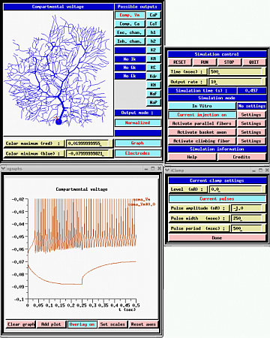
Other Simulators
Original PDP simulator developed by McClelland and Rumelhart in 1986 is now outdated, many other followed.
General biologically oriented simulators:
GENESIS, NEURON, PSICS – detailed, compartmental neural models.
Specialized: iLab Neuromorphic Vision C++ …
Less biological: NEST, CNS, Brian, XPPAUT, XNBC, SPLIT, Mvaspike, Topographica NMS …
Formal NN: SNNS, FANN, commercial Matlab NN toolbox, Mathematica NN package, Peltarion Synapse …
Genesis enables comparison with real neurophysiological measurements.
Emergent compared to other neural network simulators:
http://grey.colorado.edu/emergent/index.php/Comparison_of_Neural_Network_Simulators
Notes:
(c) 1999. Tralvex Yeap. All Rights Reserved
4

Slide 5
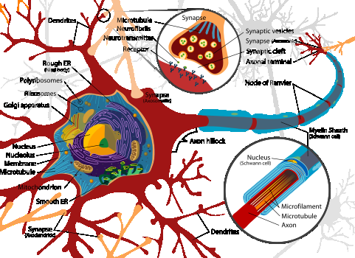
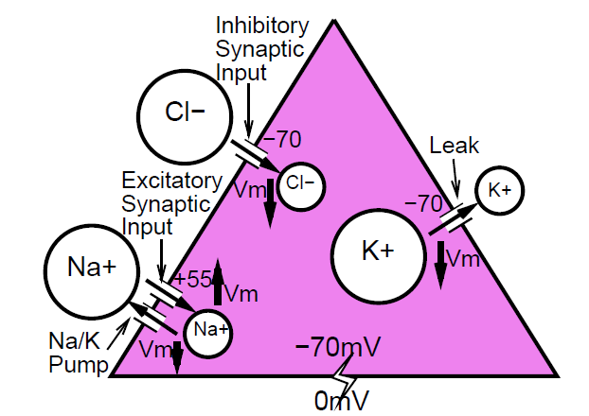
Neuron or abstraction?
Neurons are very complex biological cells.
Simplest description that preserves some interesting biophysical properties treats them as point objects (no geometrical parameters) that can be charged by positive ions (excitatory input) flowing through ion channels in membranes and synapses.

Slide 6
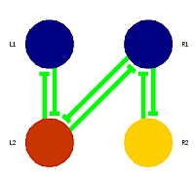

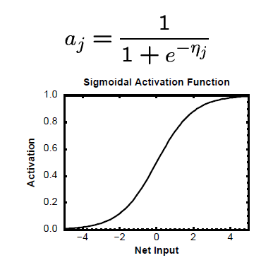
Abstract neuron
Add all inputs taking into account synaptic strength.
Neuron activation cannot grow indefinitely: pass the total net input through a sigmoidal limiting function, symbolizing maximum spiking frequency.
Rate coding: output activation does not exceed a unit vale, or maximum rate.
Is this how neurons respond?
No, but this is how the average number of impulses per second changes as a function of neuron’s activation.
Notes:
(c) 1999. Tralvex Yeap. All Rights Reserved
6

Slide 7
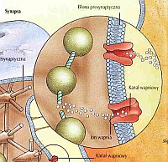
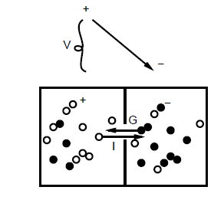
Biological Neurons
Ions flow through the neurons’ membranes under the forces of electricity and concentration gradients,
changing their polarization V_{m}
Sodium ions Na⁺, potassium K⁺, calcium C⁺⁺, chloride Cl⁻ flow until the charge distribution is equalized; their imbalance creates the electrical potential which tries to restores the balance.
Ions flow through channels overcoming resistance I = V/R:
Conductivity is G=1/R, so I=VG (Ohms law).
Diffusion generates current I in proportion to ion concentration C
I = -DC (Fick's First law)
Equilibrium potential E counteracts diffusion:
I = G(V-E)
Notes:
(c) 1999. Tralvex Yeap. All Rights Reserved
7

Slide 8
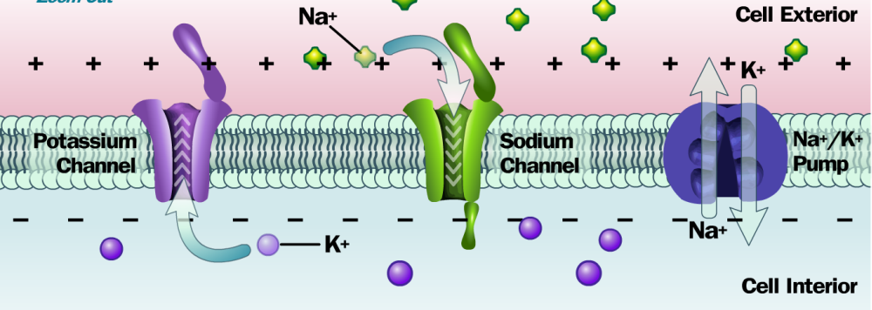
Ions and Neurons
Everything follows from the sodium pump, which creates the “dynamic tension” for subsequent neural action. Neurotransmitters activate some ion channels.
Glutamate → opens Na+ channels → Na+ enters (excitatory)
GABA → opens Cl⁻ channels → Cl⁻ enters if V_{m} < threshold (inhibitory)
Alcohol closes sodium channels Na, general anesthesia: opens K.
Scorpions have various toxins, eg. open Na, closes K.
Nice illustration of ion channel functions at the “mind project”.
Notes:
(c) 1999. Tralvex Yeap. All Rights Reserved
8

Slide 9
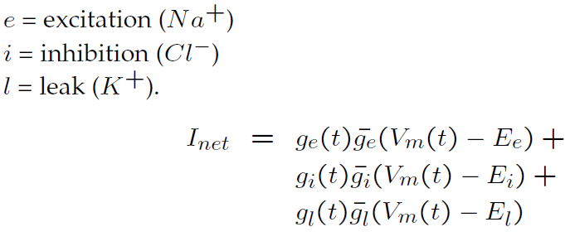
Putting it Together
To find potential V_{m} for each ion one needs to consider its equilibrium potential E_{c},
g_{c}(t) is a fraction of ion channels that are open in a given moment,
ĝ_{c} is max. conductivity of all channels;
therefore a produce ĝ_{c} g_{c}(t) gives us conductivity.
Considering diffusion, current for a given ion is:
I_{c} = ĝ_{c} g_{c}(t) (V_{m}(t)−E_{c})
For equilibrium potential there is no current, I_{c}=0.
Total current for 3 most important channels:
Notes:
(c) 1999. Tralvex Yeap. All Rights Reserved
9

Slide 10
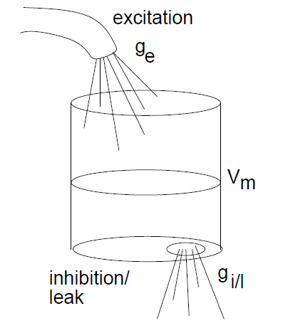
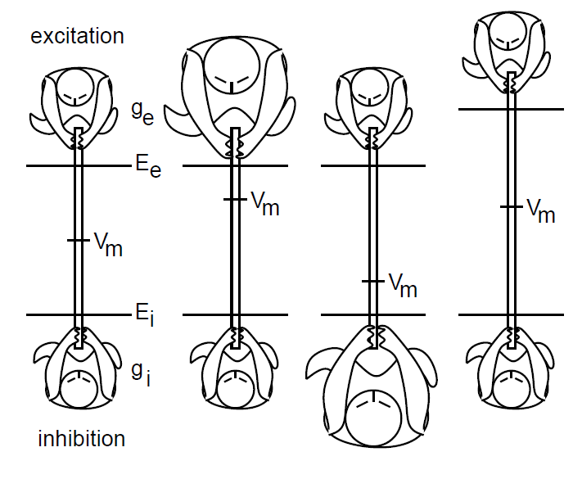
Leaky bucket analogy
Good analogy to ion flow:
g_{e} is the rate of flow into bucket;
g_{i} and g_{l} are rates of “leak” out of bucket,
due to pump and spontaneous flow.
Resulting water level?
V_{m} results from balance between all these forces.
Like balance in a tug-of-war (rope pooling)
Notes:
(c) 1999. Tralvex Yeap. All Rights Reserved
10

Slide 11

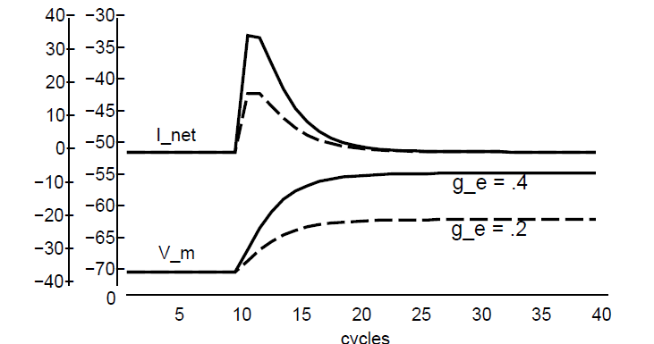
Two inputs
As a result of the current flow I_{net} potential changes with some time delay dt_{vm}:
Two excitatory inputs at time t =10, assuming conductances g_{e}=ĝ_{e}g_{e}(t) = 0.2 g_{i} = 0.4 and g_{l} = 2.8
Current flows until equilibrium is reached. If there are constant excitations (open channels) neuron reaches new equilibrium potential.
Notes:
(c) 1999. Tralvex Yeap. All Rights Reserved
11

Slide 12

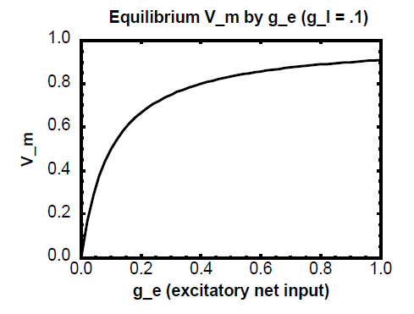
Equilibrium Potential
If I_{net}=0 then we can compute V_{m} (normalized threshold 0.25):
We can now solve for the equilibrium potential as a function of inputs.
Simplify: ignore inhibition for a moment, set E_{e}=1 a E_{i}=0 (leaks are always on E_{l}=1)
Membrane potential computes a balance (weighted average) of excitatory and inhibitory inputs.
Notes:
(c) 1999. Tralvex Yeap. All Rights Reserved
12

Slide 13
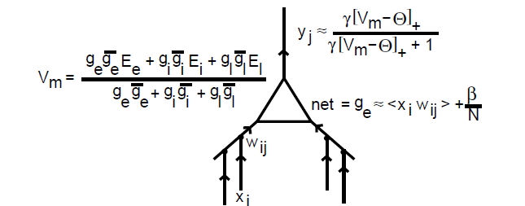
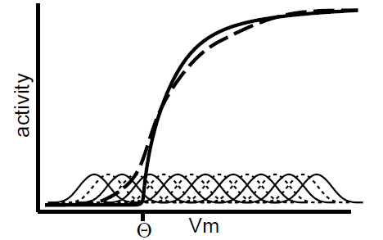
Computational Neurons Summary
Use bias β and activation threshold Θ to compute the output signal with the total number of input connections N ([ . ]₊ is a positive part):
Weights = synaptic efficacy; weighted input
= x_{i}w_{ij}.
Net conductance (average across all inputs)
excitatory (net = g_{e}(t)), inhibitory g_{i}(t).
Function γx/(γx+1) combined with Gaussian noise is similar to sigmoidal,
Parameter γ regulates the slope.
Notes:
(c) 1999. Tralvex Yeap. All Rights Reserved
13

Slide 14
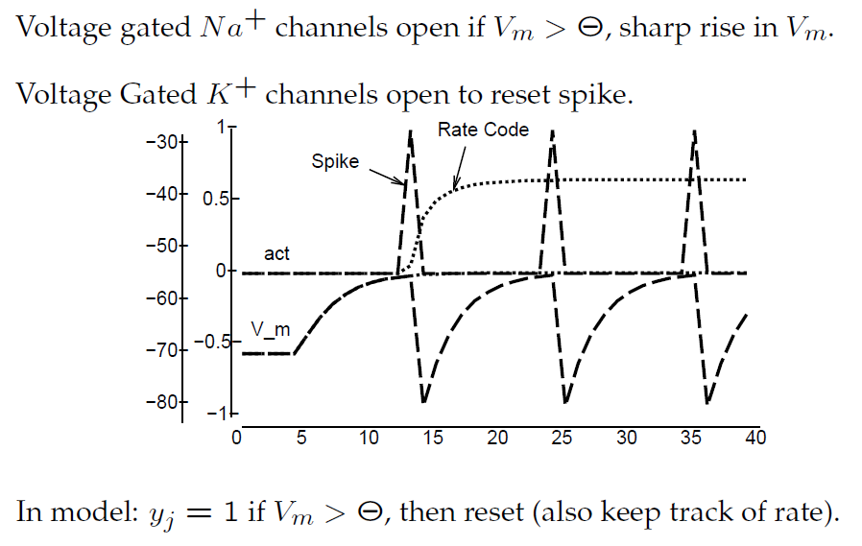
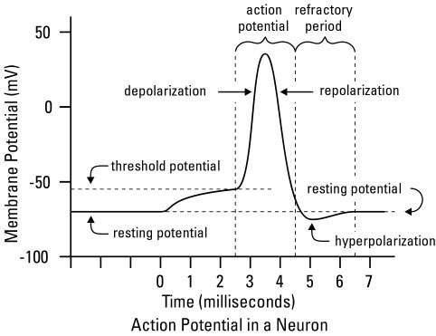
Thresholded Spike Outputs
Neuron’s behavior is a result of currents equilibrium in various channels. Approximating more accurate shape is not that important.
Notes:
(c) 1999. Tralvex Yeap. All Rights Reserved
14

Slide 15
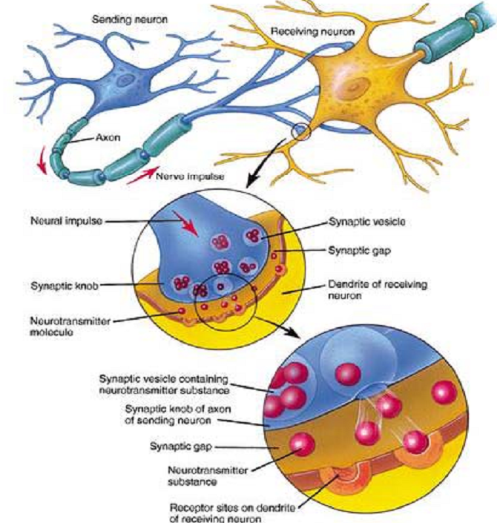
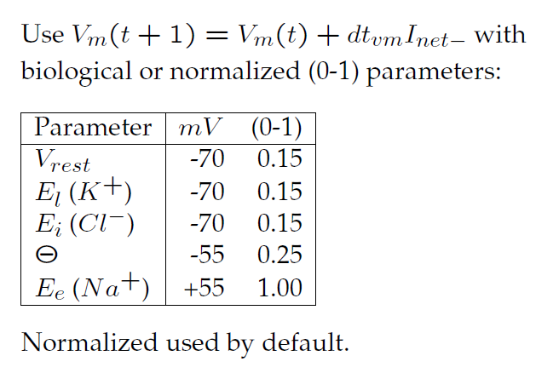
Parameters
Emergent allows to simulate neurons with realistic parameters.
Notes:
(c) 1999. Tralvex Yeap. All Rights Reserved
15

Slide 16
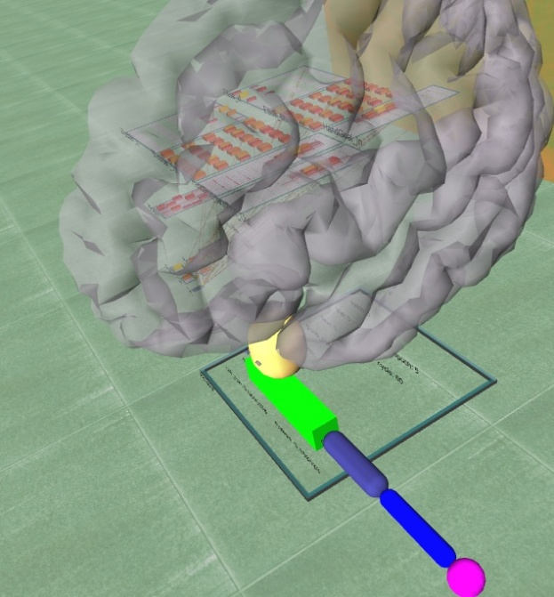
Emergent:
Emergent is a powerful tool for simulation of biologically plausible, complex neural networks:
http://grey.colorado.edu/emergent
Simulating the brain functions
Emergent supports:
Classic back-propagation and recurrent back-propagation and variants,
Constraint-satisfaction (CS) including the Boltzmann Machine, Interactive Activation and Competition, and other related algorithms;
Self-organized learning including Hebbian Competitive learning and variants, with Kohonen's Self-Organizing Maps and variants
Leabra (``local error-driven and biologically realistic algorithm'')
Real Time Neural Simulator
Long Short Term Memory
Oscillating Inhibition Learning Mechanism
Notes:
(c) 1999. Tralvex Yeap. All Rights Reserved
16

Slide 17
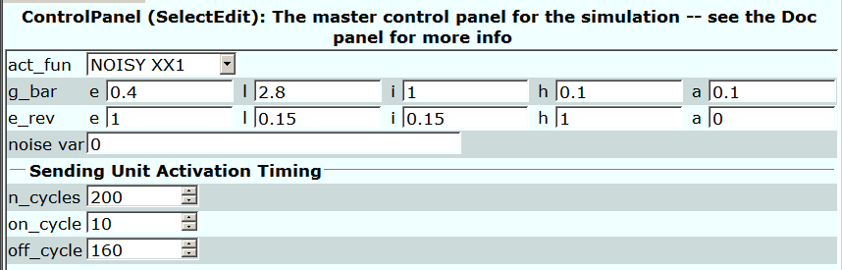
Emergent: Unit.Proj
Emergent has many parameters regulating activity of neurons.
act_fun activation function: Noisy xx1; can be chosen without noise, linear with or without noise, or spike.
g_bar_e determines fraction of channels is open during on/off_cycle.
e_rev_e is equilibrium potential for activating channels.
a = accommodation, increase of Ca⁺⁺ concentration in neuron
=> opens inhibitory channels (usually K⁺) – section 2.9.
h = hysteresis, reaction slowdown, active neurons remain active for some time after the excitation is removed.
Notes:
(c) 1999. Tralvex Yeap. All Rights Reserved
17

Slide 18
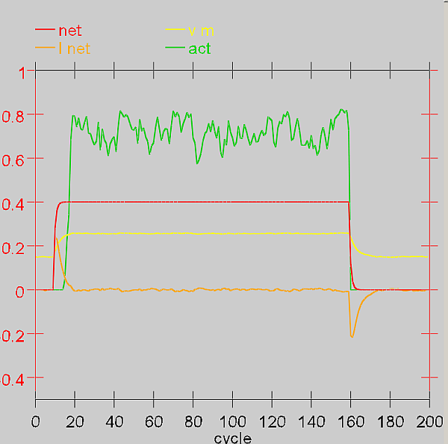
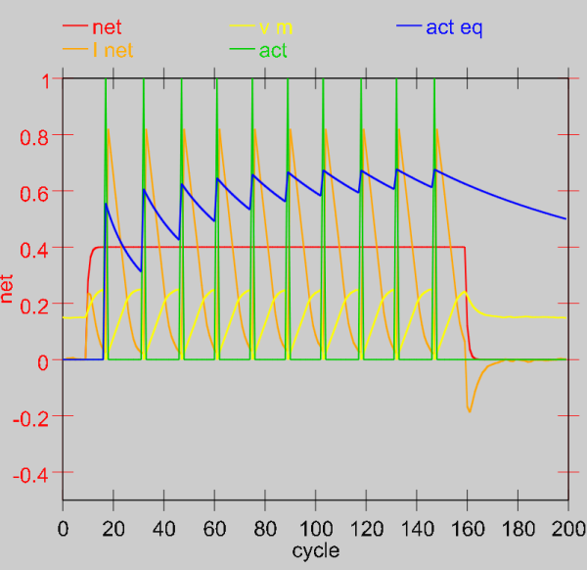
Emergent: results
Net = total excitation changes from 0 to g_bar_e=1 (all channels open).
I_net: current flows to the neuron, equilibrium is reached, then it flows out of the neuron.
V_m is axon potential, increases from -70mV (here 0.15) to +50mV (here 0.30).
Act = output activation; if spikes are selected then they will show
on the figure
Single impulses; fluctuations result form noise,
here there is a small noise variance = 0.001
Act eq = equivalent of average rate-code.
Notes:
(c) 1999. Tralvex Yeap. All Rights Reserved
18

Slide 19
Advantages of model simulations
Models help to understand phenomena:
enable new inspirations, perspectives on a problem
allow to simulate effects of damages and disorders (drugs, poisoning)
help to understand behavior
models can be formulated on various levels of complexity
models of phenomena overlapping in a continuous fashion (e.g. motion or perception)
models allow detailed control of experimental conditions and exact analysis of the results.
Models require exact specification of underlying assumptions:
allow for new predictions
perform deconstructions of psychological concepts (working memory?)
allow to understand the complexity of a problem
allow for simplifications enabling analysis of a complex system
provide a uniform, cohesive plan of action

Slide 20
Disadvantages of simulations
One must consider limitations of designed models:
Models are often too simple, they should contain many levels.
Models can be too complex, theory may give simpler explanation
  why there are no hurricanes on the equator? - due to Coriolis effect
It’s not always known what to provide for in a model.
Even if models work, that doesn’t mean that we understand the mechanisms.
Many alternative yet very different models can explain the same phenomenon.
Models need to be carefully designed to fit the observations:
What’s important in building a model are general rules
  the more phenomena a model explains, the more plausible and universal it is.
Allowing for interaction and emergence (construction) is very important.
Knowledge acquired from models should undergo accumulation.

Slide 21
Q1
Please answer these questions given here for each unit.
CECN1 Units (units.proj) -- Individual Neuron (Unit)
Question 2.3
(a) How does the response of the unit change when you change g_bar.l? Why?
(b) How does this differ from changes to g_bar.e?
(c) Use the same technique you used in the previous question to compute the exact amount of leak current necessary to put the membrane potential exactly at threshold when the g_bar.e value is at the default of .4 (show your math).

Slide 22
Q2
Please answer these questions given here for each unit.
CECN1 Detector (detector.proj) -- The Unit as a Detector,
Question 2.9
(a) What happens to the pattern of receiving unit activity when you reduce g_bar.l to 6?
(b) What happens with g_bar.l values of 4, 1, and 8?
(c) Explain the effect of changing g_bar.l in terms of the point neuron activation function.
(d) What might the consequences of these different response patterns have for other units that might be listening to the output of this receiving unit?
Try to give some possible advantages and disadvantages for both higher and lower values of g_bar.l

Slide 23
Q3
Please answer these questions given here for each unit.
CECN1 Transform (transform.proj) -- Transformations produced by feedforward neural processing
Question 3.3:
(a) What happens generally to the hidden activations with this reduction in leak value?
(b) How does this affect the cluster plot of hidden unit activities?
(c) How about for a g_bar.l of 4?
(d) If the goal of this network was to have the same hidden representation for each version of the same digit, and different representations for different digits, how does changing the units' excitability (via the leak current) affect the success of the network, and why?''

Slide 24
Q4
Please answer these questions given here for each unit.
CECN1 Localist vs Distributed (loc_dist.proj) -- Localist vs Distributed representations
Question 3.5 The distributed network achieves a useful representation of the digits using half the number of hidden units as the localist network (and this number of hidden units is 1/7th the number of input units, greatly compressing the input representation) - explain how this efficiency is achieved.

