Slide 1

Advanced Topic in Cognitive
Neuroscience and Embodied Intelligence
Lab 4/5
Networks of neurons
and what they can do.
Prof. Janusz Starzyk has made a version of the Emergent lab notes based on my notes in Polish language, so now I am using his ☺
CE7427

Slide 2
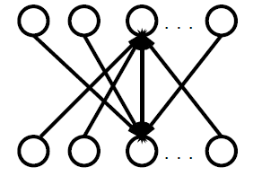
Feedback
Networks almost always have feedback between neurons.
Recurrence: secondary, repeated activation; from this come networks with recurrence (bidirectional).
Advantages of feedback in NN:
?

Slide 3
Feedback
Networks almost always have feedback between neurons.
Recurrence: secondary, repeated activation; from this come networks with recurrence (bidirectional).
Bottom-up and top-down, or recognition and imagination.
Recurrence makes possible the completion of images, formation of resonances between associated representations, strengthening of weak activations and the initiation of recognition.
Example: recognize the second letter in simple words:
NEST REST DEST SEST
In such tests people recognize E faster in real words. Text recognition proceeds from letters to words; so how does a word help in the recognition of a letter?

Slide 4
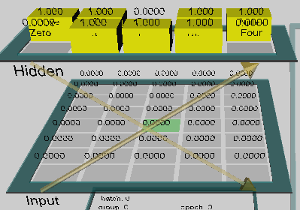
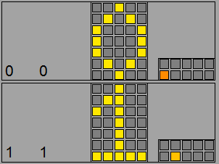
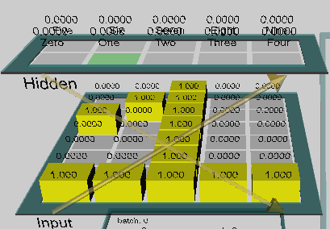
Recurrence for digits
A network with a hidden layer 2x5, connected bi-directionally with the inputs. Symmetrical connections:
the same weights W_{ij}=W_{ji}.
The center pixel activates 7 hidden neurons,
each hidden neuron activates all the pixels of a given digit, but the inputs are always taken from the images of the digits.
Combinations of hidden neuron activations

Slide 5
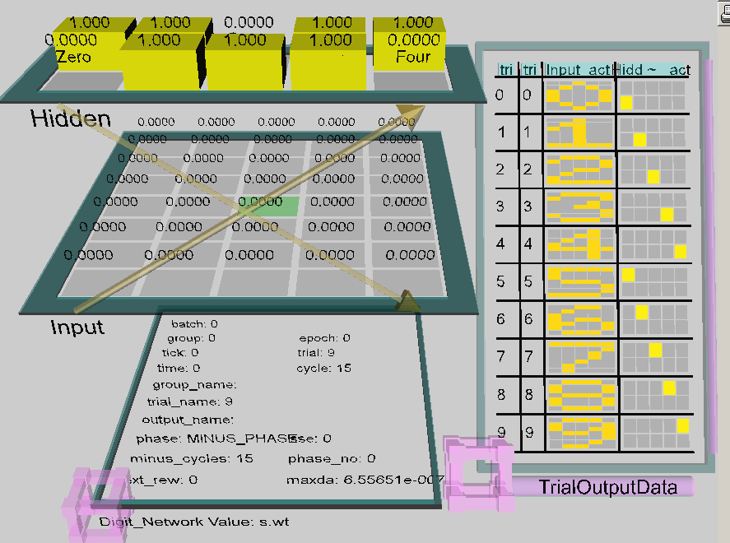
Bidirectional flow
Clamped inputs and then outputs

Slide 6
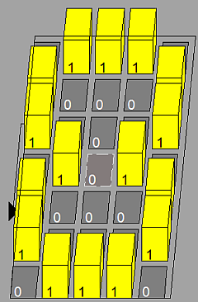
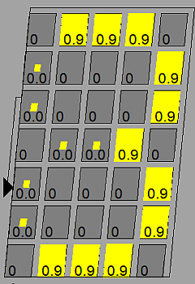
Completion of images
Project pat_complete.proj in Chapter_3.
A network with one 5x7 layer, connected bi-directionally with itself.
Symmetrical connections: the same weights W_{ij}=W_{ji}.
Units belonging to image 8 are connected to themselves with a weight of 1, remaining units have a weight of 0.
Activations of input units here are not fixed by the images (hard clamping), but only initiated by the images (soft clamping), so they can change.
Check the dependence of the minimum number of units sufficient to reconstruct the image from the conductivity of ion channels.
For a large ĝ_{l} start from a partial image requires a greater and greater number of correctly initialized pixels, for ĝ_{l} = 3 we need >6 pixels, for ĝ_{l} = 4 we need >8 pixels, for ĝ_{l} = 5 we need >11 pixels.

Slide 7
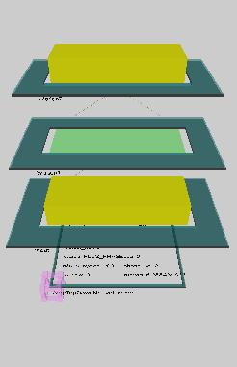
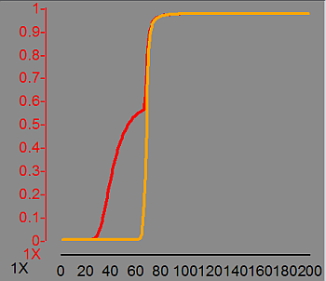
Recurrent amplification
Project amp_top_down.proj in Chapter_3.
From a very weak activation of some image, amplification processes can lead to full activation of the image or uncontrolled activation of the whole network.
The network currently has two hidden layers.
A weak excitation leads to a growth in activation of neuron 2, and reciprocal activation of neuron 1.
For a large ĝ_{l}>3.5 the effect disappears.
The same effect can be achieved through feedback inside a single layer.
Weak activation of letters suffices for word recognition, but word recognition can amplify letter activation and accelerate the response.

Slide 8
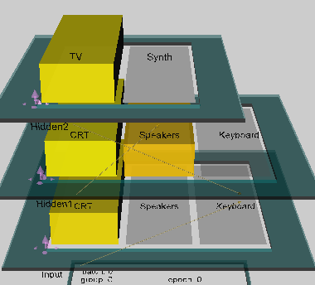
Amplifying DR
Project amp_top_down.dist.proj in Chapter_3.
Distributed activation can lead to uncontrolled activation of the whole network.
Two objects: TV and Synthesizer; 3 features: CRT monitor, Speaker and Keyboard.
The TV has CRT and Speaker, the Synthesizer has Speaker and Keyboard – one feature in common.
Feedback leads to activation of layer 1, then 2, then
1 again, repeatedly. From the ctrl panel we select GridView, then Run choosing UniqueEnv input data.
Starting from an arbitrary activation at the input, Speaker activates both neurons, TV and Synthesizer, and all 3 features in layer 1, in effect all elements are completely active.
Manipulating the value of ĝ_{l} ~ 1.737 shows how unstable these networks are => we need inhibition!

Slide 9
Inhibitory interactions
We need a mechanism which reacts dynamically, not a constant leak current – negative feedback, inhibitory neurons.
What are the uses of inhibition:
?

Slide 10
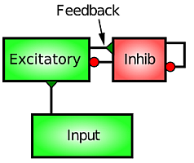
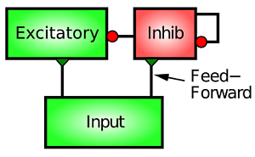
Inhibitory interactions
We need a mechanism which reacts dynamically, not a constant leak current – negative feedback, inhibitory neurons.
Two types of inhibition: thanks to the use of these same input projections, we can anticipate activations and inhibit directly; this selective inhibition allows for the selection of neurons best suited to specific signals.
Inhibition can also be a reaction to excessive activation of a neuron.
Inhibition leads to sparse distributed representations.
Feedforward inhibition: depends on
the activation of the lower level
Feedback inhibition: reacts to
activation within the layer

Slide 11
Inhibitory parameters
A model with inhibitory neurons is costly: there are additional neurons and the simulation must be done with small increments in time to avoid oscillation.
We can use simpler models with competition among neurons, leading to the selection of a generally small number of active neurons (sparse distributed representation).
Inhibitory parameters:
g_bar_i_inhib, self-inhibition of a neuron
g_bar_i_hidden, inhibition of hidden neurons
scale_ff, weight of ff connections, input-inhibition
scale_fb, weights of reciprocal connections

Slide 12
WTA and SOM approximation
Winner Takes All, leaves just 1 active neuron and doesn't lead to distributed representation.
In the implementation of Kohonen’s SOM the winner is chosen along with its neighborhood. Activation of the neighborhood depends on distance from the winner.
Other approaches use combinations of excitatory and inhibitory neurons:
  McClelland and Rumelhart – interactive activation and competition;
  introduced the superiority of the higher layer over the lower, allowing for the supplementation of missing features and making predictions
Layer 6
- next
layer
2/3
interaction
4
feedback
5
inhibition
6
input activation
  Grossberg introduced bi-directional connections between layers using minicolumnar structures with
  separate inhibitory neurons

Slide 13
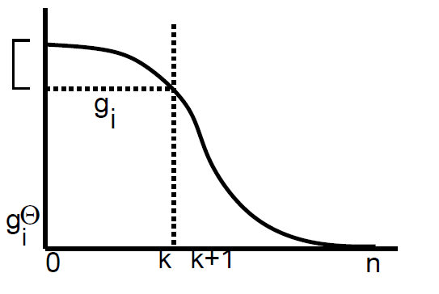
kWTA approximation
k Winners Take All, the most common approximation: leave k active neurons.
Idea: inhibitory neurons decrease activation so that no more than k neurons can be active at the same time.
Find the k most active neurons in the layer; calculate what level of inhibition is necessary so that only these remain above the threshold.
The distribution of activation levels in a larger network should have a Gaussian character.
We have to find this level of threshold activation g_{i}^{Θ} so that for a value between k and k+1 it could be balanced by inhibition:
Two methods: basic and averaged.
Weaker winners are eliminated by the minimal threshold value
kWTA model constitutes a simplification of biological interactions

Slide 14
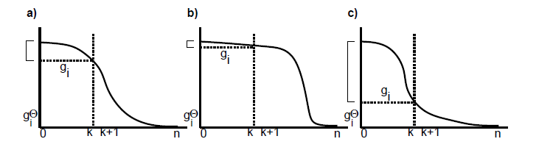
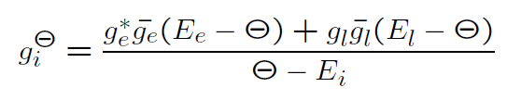

Basic kWTA
Equilibrium for potential Θ for which currents don't flow is established by the level of inhibitory conductance.
For confirmation, that only k neurons are above the threshold we take:
Typically constant q=0.25; depending on the distribution of excitation across the layer, we can have a clear separation (c) or inhibit highly active neurons (b).

Slide 15
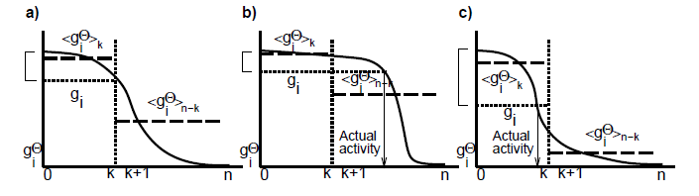
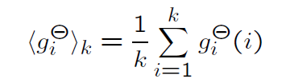


Averaged kWTA
In this version inhibitory conductance is placed between the average of the k most active neurons and the n-k remaining neurons.
An intermediate value is computed from:
Depending on the distribution we have in (b) a lower value than before but in (c) a higher value, which gives somewhat better results.

Slide 16
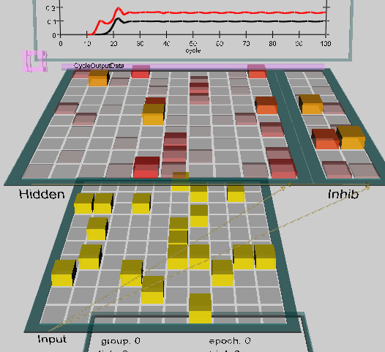
Projects with kWTA
Project inhib.proj in Chapter_3.
Input 10x10,
hidden layer 10x10
2x10 inhibitory neurons,
realistic proportions.
A bi-directional network has a second hidden layer; kWTA stabilizes excitation leaving few active neurons.
Detailed description: section 3.5.2 i 3.5.4
Project inhib_digits.proj in Chapter_3.

Slide 17
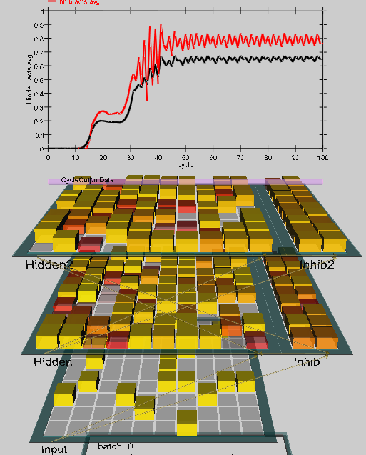
Feddback with second hidden layer
Projekt Ch3 inhib.proj.
Switch on Bdirexcite to add the second hidden layer that include inhibitory neurons.
Initial activation similar to previous, but after significantly increases after second layer is activated.
Seizure: bd_hidden_g_bar.i=1.1
Increases activity of the second layer may cause activation of all neurons.
In this model one can test different effects of inhibition and average kWTA.
Notes:
(c) 1999. Tralvex Yeap. All Rights Reserved
17

Slide 18
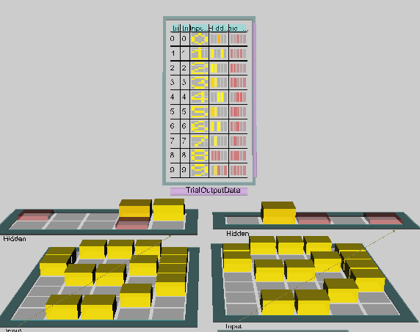
kWTA and digits
Project Ch3 inhib_digits.proj.
Network with local transformations to a single output neuron, for k=1 gives unique excitations.
For distributed outputs, inhibition may only give single active output neurons (which is not sufficient to solve the problem without another layer) but for larger k gives combination of 2 or 3 units.
Notes:
(c) 1999. Tralvex Yeap. All Rights Reserved
18

Slide 19
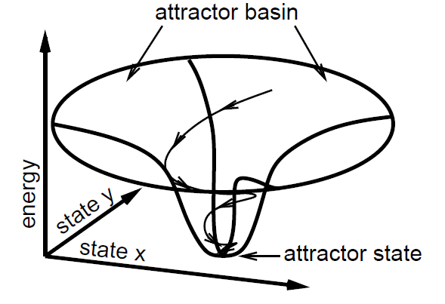
Constraint satisfaction
Environmental activations, and internal inhibition and activation compatible with the fixed parameters of the network, form a set of constraints on possible states; the evolution of activations in the network should lead to satisfaction of these constraints.
Attractor dynamics
System energy
The role of noise
Changes in time, starting from the "attractor basin,” or collection of different starting stages, approach a fixed state.
Attractor states maximize harmony between internal knowledge contained in the network parameters and information from the environment.

Slide 20

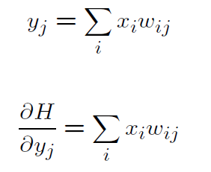
Energy
The most general law of nature: minimize energy!
What does an energy function look like?
where the summation runs through all the neuron pairs.
Harmony = −E is greatest when energy is lowest.
If the weights are symmetrical then the minimum of this energy function is at a single point (point attractor); if not then attractors can be cyclical, quasiperiodic or chaotic.
For a network with linear activation the output is =>
The derivative of harmony = y_{j} shows the direction of growth in harmony.

Slide 21
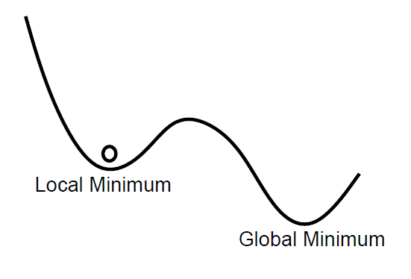
The role of noise
Fluctuations on the quantum level as well as the input from many coincidental processes in the greater neural network create noise.
Noise changes the moments of impulse transmission,
helps to prevent local solutions with low harmony,
supplies energy effecting resonance,
breaks impasses.
Noise doesn't allow a fall into routine, enables exploration of new solutions, is also probably necessary for creativity.
Noise in the motor cortex.
Demonstration of the role of noise in the visual system.

Slide 22
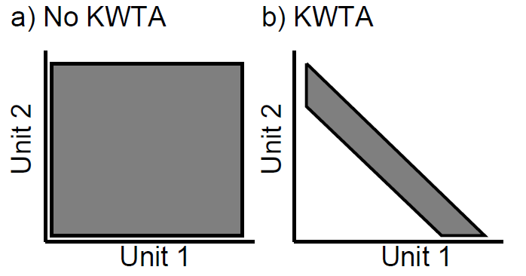
Inhibition and constraint satisfaction
Constraint satisfaction is accomplished in the network by a parallel search through the neuron activation space.
Inhibition allows us to restrict the search space, speeding up the search process if the solution still exists in an accessible area of the state space.
Without kWTA all states in the configuration of two neurons are accessible;
the effect of kWTA restriction is the coordination of activation of both neurons and a decrease in the search space.

Slide 23
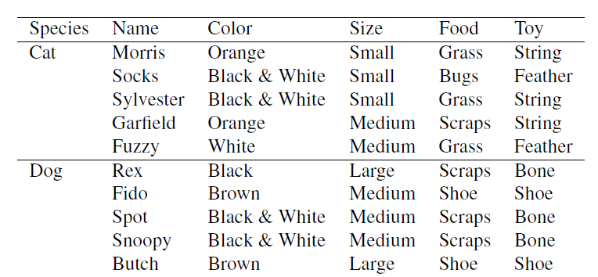
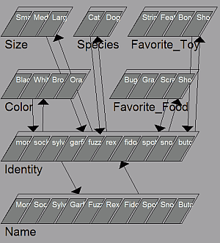
Constraint satisfaction: cats & dogs
Project cats_and_dogs.proj in Chapter_3.
The knowledge encoded in the network is in the table.
The exercise described in section 3.6.4 leads to a simple semantic network which can:
  Generalize and define unique characteristics
  Show the relationship between characteristics
  Determine if characterstics are stable
  Supplement missing information

Slide 24
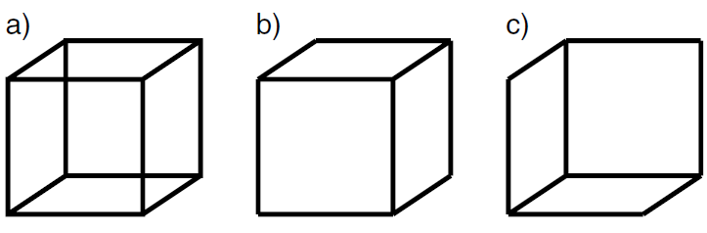
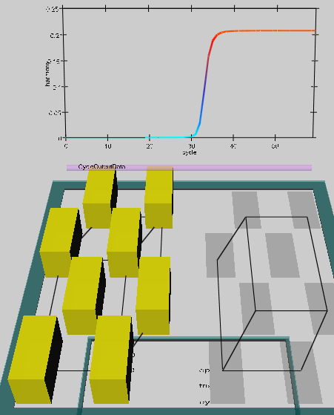
Constraint satisfaction: Necker cube
Project necker_cube.proj in Chapter_3 demonstrates bistability of perception. Bistability of perception: this cube can be seen with its closest face facing either left or right.
Bistable processes can be simulated allowing for noise.
The exercise is described in section 3.6.5.

Slide 25
Q1
Please answer these questions given here for each unit.
CECN1 Pattern Completion (pat_complete.proj) -- Pattern completion
Question 3.7 (a) Given the pattern of weights, what is the minimal number of units that need to be clamped to produce pattern completion to the full 8? Toggle off the units in the event pattern one-by-one until the network no longer produces the complete pattern when it is Run.
(b) The g_bar_l parameter can be altered (in the ControlPanel) to lower this minimal number. What value of this parameter allows completion with only 5 inputs active? Change the g_bar_l value back to 3
Question 3.8 (a) What happens if you activate only inputs which are not part of the 8 pattern? Why this happens?
(b) Could the weights in this layer be configured to support the representation of another pattern in addition to the 8 (such that this new pattern could be distinctly activated by a partial input), and do you think it would make a difference how similar this new pattern was to the 8 pattern? Explain your answer.

Slide 26
Q2
Please answer these questions given here for each unit.
CECN1 Distributed Top-down Amplification (amp_top_down_dist.proj) -- Top-down amplification in distributed network
Question 3.9 (a) List the values of g_bar.l where the network's behavior exhibited a qualitative transition in what was activated at the end of settling, and describe these network states.
(b) Using the value of g_bar.l that activated only the desired two hidden units at the end of settling, try increasing the dt_vm parameter from .03 to .04, which will cause the network to settle faster in the same number of cycles by increasing the rate at which the membrane potential is updated on each cycle -- this is just like running the network for longer. Do only the left two hidden feature units still become active? What does this tell you about your previous results? (Hint - if the network is were left to settle indefinitely, do you think there's any value of leak that would allow the features of TV but not Synth to become active?

Slide 27
Q3
Please answer these questions given here for each unit.
CECN1 Cats and Dogs (cats_and_dogs.proj) -- Constraint satisfaction in the Cats and Dogs model
Question 3.15
(a) Explain the reason for the different levels of activation for the different features of cats when just Cat was activated.
(b) How might this be useful information?
(c) Activate the Orange color input in addition to Cat, and press Run.
The initial harmony value was slightly larger (reflecting the greater excitation present from the input), the final harmony value was significantly lower that that for just Cat alone. Why?

Slide 28
Q4
Please answer these questions given here for each unit.
CECN1 Necker Cube (necker_cube.proj) -- Constraint satisfaction and the role of noise and accommodation in the Necker Cube model
Question 3.16.
a) Try the following values of noise.var in the .PanelTab.ControlPanel:
0, .1, .01, .000001.
Report what differences you observed in the settling behavior of the network for these different values.
(b) What does this tell you about how noise is affecting the process?
(c) Can you observe oscillations between two situations? What is needed to see such oscilations?

