Slide 1
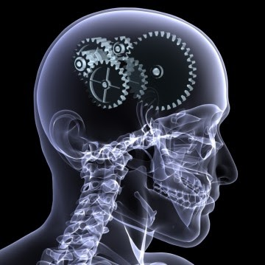
Advanced Topic in Cognitive
Neuroscience and Embodied Intelligence
Week 5
Self-organizing, Hebbian and error-driven learning.
CE7427

Slide 2

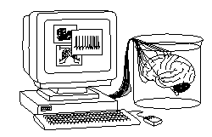
What it will be about
Self-organized learning: creating topographic representations.
Hebbian correlation learning.
Error-driven task learning.

Slide 3
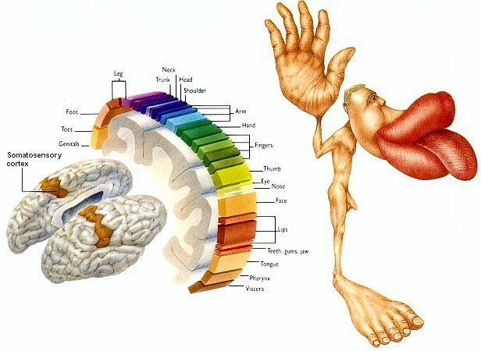
Topographical representations
Self-organization is modeled in many ways; simple models are helpful in explaining qualitative features of topographic maps.
Many examples, best known are somatosensory and motor primary cortex, but many other motor and sensory areas have topographical organization, including visual and auditory areas.
Quantization of perception is useful.
How can it arise?

Slide 4

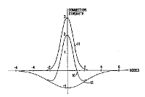
Simplest models
Emergent has examples of self-organization of receptive fields in V1 cortex.
SOM or SOFM (Self-Organized Feature Mapping) – self-organizing feature map, one of the most popular brain-inspired models.
How can topographical maps be created in the brain?
Local neural connections create strong groups interacting with each other, weaker across greater distances and inhibiting nearby groups.
History:
von der Malsburg & Willshaw (1976), competitive learning, Hebbian learning with "Mexican hat" potential, mainly visual system.
Amari (1980) – layered models of neural tissue.
Kohonen (1981) – simplification without inhibition; left only two essential processes: competition and cooperation.
Interaction strength: local cooperation, further inhibition

Slide 5
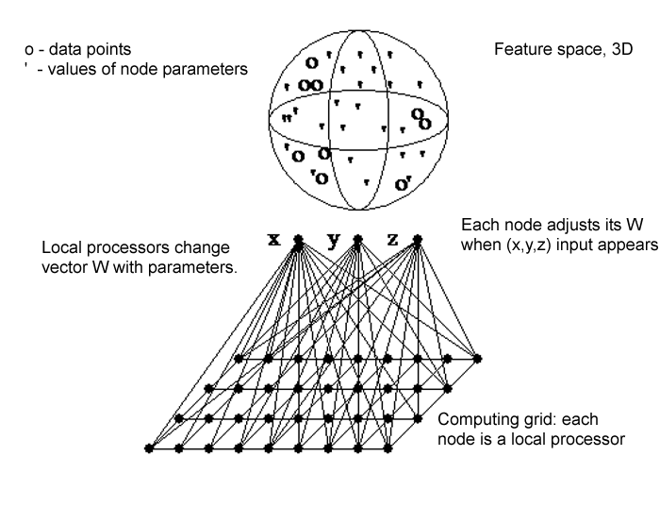
SOM: idea
Data: vectors X^{T} = (X₁, ... X_{d}) from d-dimensional space (samples of signals).
Network: nodes with local processors (neurons or columns) in each node.
Each local processor # j has d adaptive parameters W^{(j)}.
Goal: adjust the W^{(j)} parameters to model clusters in the X space.
Sensory data are spatio-temporal, here only rough features of their distribution is determined, this makes it more robust to noise and irrelevant details.
Node parameters represent synaptic strength of neurons receiving projections from lower levels (for ex. SI from thalamus); initially they may receive data from random areas, but learning will self-organize overlapping receptive fields.

Slide 6
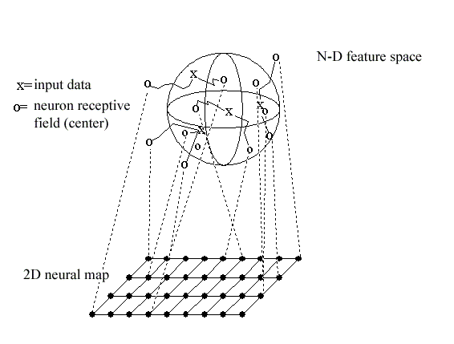
Training SOM
A strip of somatosensory cortex may have neurons reacting to tactile stimuli from different parts of the space, but with sufficient stimulations neurons in the mesh will move their receptive fields (changing their synaptic connections, represented by weight vectors in the model) becoming more sensitive to the areas where real data comes from most often.
Creation of topographical maps and modeling of brain plasticity
(PPT presentation, 2001, mapping human body).

Slide 7
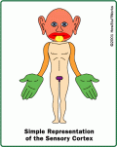
SOM algorithm: competition
Nodes should calculate similarity of input data to their parameters.
Input vector X is compared to the current node parameters W.
Similar = minimal distance or maximal scalar product.
Competition: find node j=c with W most similar to X.
Node number c is most similar to the input vector X
It is a winner of the competition who can handle this input, hence this is a “competitive learning” procedure.
According to Hebb rule, the node should learn to be more similar to X.
In the brain those neurons that react to some signals will increase their activation in time, learning to analyze this signal in a better way.

Slide 8

SOM algorithm: cooperation
Cooperation: nodes on a grid close to the winner c should behave similarly. Define the “neighborhood function” O(c):
t – iteration number (or time);
r_{c} – position of the winning node c (in physical space, usually 2D).
||r − r_{c}|| – distance from the winning node, scaled by σ_{c}(t).
ε₀(t) – slowly decreasing multiplicative factor
The neighborhood function determines how strongly the parameters of the winning node and nodes in its neighborhood will be changed, making them more similar to data X.

Slide 9
SOM algorithm: dynamics
Adaptation rule: take the winner node c, and those in its neighborhood O(r_{c}), change their parameters making them more similar to the data X
Randomly select new sample vector X, and repeat.
Decrease h₀(t) slowly until there will be no changes.
Result:
W(i) ≈ the center of local clusters in the X feature space
Nodes in the neighborhood point to adjacent areas in X space

Slide 10
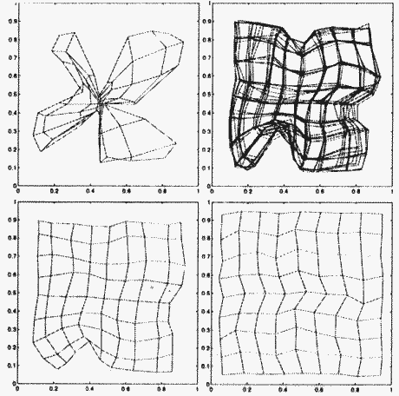
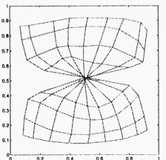
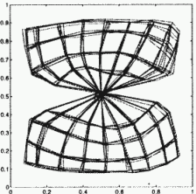
Maps and distortions
Initial distortions may slowly disappear or may get frozen if plasticity rapidly decreases ... leaving the brain with a completely distorted view of reality.
Most people in the world believe in some conspiracy theories …

Slide 11
Demonstrations using GNG
Self-Organizing Networks java GNG demos
Many versions of competitive learning implemented in Java.
Parameters of the program:
t – iterations
ε(t) = ε_{i} (ε_{f} / ε_{i} )^{t/tmax} specifies a step in learning
σ(t) = σ_{i} (σ_{f} / σ_{i} )^{t/tmax} specifies the size of the neighborhood
Maps 1x30 show the formation of Peano's curves.
An attempt to reconstruct Penfield's maps from responses to touch.

Slide 12
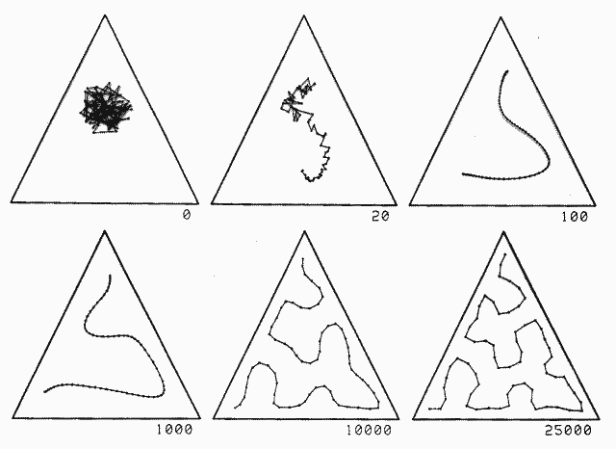
2D => 1D in a triangle
The line in the data space forms a Peano curve, an example of a fractal.
Why?

Slide 13
What it will be about
Self-organized learning: creating topographic representations.
Hebbian correlation learning.
Error-driven task learning.

Slide 14
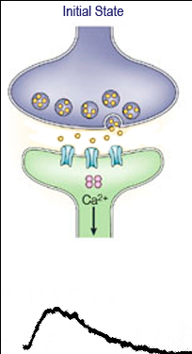
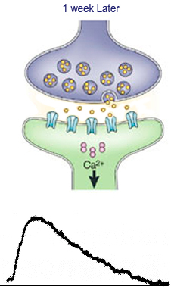
Hebbian learning in primary cortex
Nagasena-Meander dialogue (100 BC): if it were to rain again, where will this rain water flow? It will flow in the same way as the first water had gone.
Electrical current in the brain flows the same way (W. James, 1890).
Donald Hebb (1949): Neurons the fire together, wire together.
Biological mechanism: synaptic plasticity, or Long Term Potentiation (LTP) and Long Term Depression (LTD).
Synchronous stimulation enhances signal transmission between neurons, lasting from minutes to month.
Associativity and cooperativity: weak stimulation of several pathways increases LTP effect; strong simulation of one increases other path stimulated weakly.
Memory formation (but only spatial memory demonstrated), role in addiction.

Slide 15
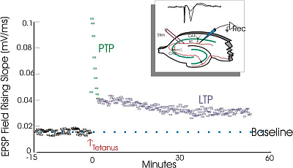
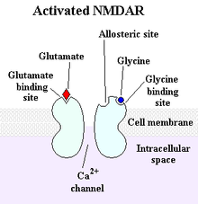
Biological foundations: LTP, LTD
Long-Term Potentiation (LTP) was discovered in 1966 first in the hippocampus, then in the cortex.
Stimulating a neuron with a current
of ~100Hz for 1 second increases
synaptic efficiency by 50-100%,
and it is a long-term effect.
Opposite effect:
LTD, Long-Term Depression.
The most common form of LTP/LTD is related to NMDA (glutamate) receptors.
Activity of NMDA channels requires presynaptic as well as postsynaptic activity, in compliance with the Hebb rule.
Many other forms of synaptic plasticity exist: short term neural facilitation (paired pulse facilitation) and depression, spike-timing-dependent plasticity (STDP, involves temporal aspects of Hebb rule), and synaptogenesis.

Slide 16
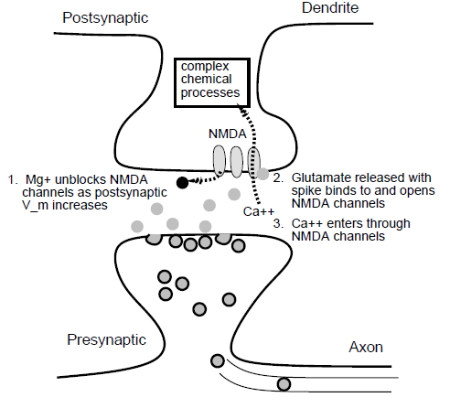
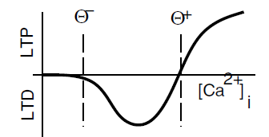
NMDA receptors
1. Mg²⁺ ions block NMDA channels.
An increase in postsynaptic potential is necessary to remove them and enable interactions with glutamate.
2. Presynaptic activity is necessary to release the glutamate, which opens NMDA channels.
3. Ca²⁺ ions enter these channels triggering a series of chemical reactions, which are not yet completely understood.
The effect is nonlinear: small amounts of Ca²⁺ lead to LTD, and large amounts to LTP. Many other processes play a role in LTP.
More detailed information on LTP/LTD.

Slide 17
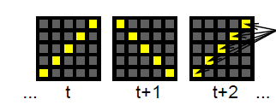
Model learning
Internal representations of patterns appearing in incoming signals in the environment of a given neural group.
Discovering correlations between signals.
positive correlation
Elements of images, movements, animal behavior or emotions, we can correlate everything by creating a behavioral model.
Only strong correlations are relevant, there are too many weak ones and they can be coincidental.
Example: hebb_correl.proj, in Chapter 4.

Slide 18
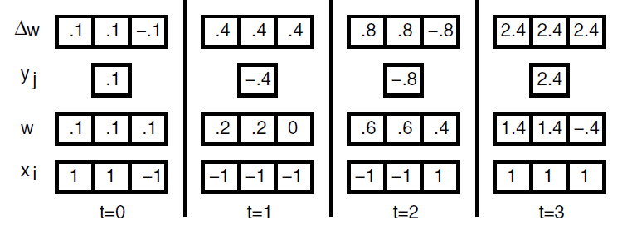
Example
The two first inputs are completely correlated; the third is uncorrelated.
Changes follow according to Hebb's rule for ε=1.
x_{i}
y_{j}=x*w
Let the signals be zero on average (x_{i}=+1 the same number of times as x_{i}=-1);
for each vector x =(x₁,x₂,x₃), y is calculated, and then the new weights.
Correlated units determine the symbol and scale of the weights,
and weights of these inputs grow quickly, whereas the weight of the uncorrelated input x₃ decreases.
The weights of unit j change in this way: w_{j}(t+1)=w_{j}(t)+Δw_{j}(t)

Slide 19
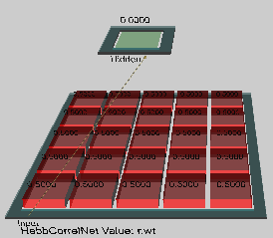
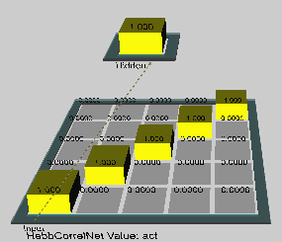
Simulation
Select: hebb_correl.proj, in Chapter 4
Click on r.wt in the network window,
after clicking on the hidden neuron we see that weights of the entire network have been initialized to 0.5.
Click on act in the network window, on
run in the control window
In effect we get binary weights =>
lrate = ε =0.005
pright = probability of the first event
Defaults changes pright =1 to 0.7

Slide 20
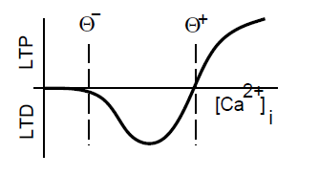
Hebb - normalization
Simple Hebb's rule: Δw_{ij} = ε x_{i} y_{j}
leads to an infinite increase in weights.
This can be avoided in many ways;
often employed is a normalization of weights:
Δw_{ij} = ε (x_{i} -w_{ij}) y_{j}
This has a biological justification:
when x and y are large we have a strong LTP, much Ca⁺⁺
when y is large but x is small we have LTD, some Ca⁺⁺
when y is small nothing happens because Mg²⁺ ions block the NMDA channels.

Slide 21
Model learning
Hebb's mechanism allows for learning correlations.
What happens if we add more postsynaptic neurons?
They will learn the same correlations!
If we use kWTA then output units will
compete with each other.
Learning = survival of the fittest (Darwin's mechanism) + specialization.
Learning based on self-organization:
Inhibition of kWTA: only the strongest units remain active.
Hebbian learning: the winners become even stronger.
Result: different neurons react to different signal properties.

Slide 22
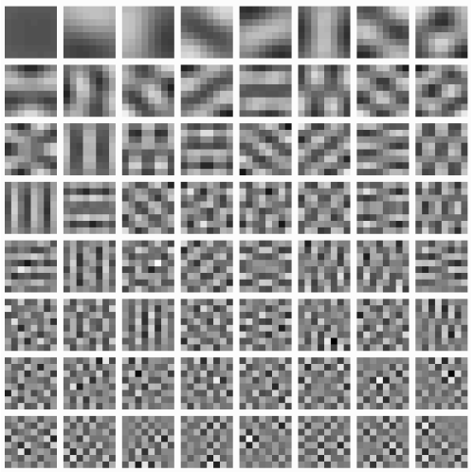
Standard PCA
Principal component analysis (PCA) is a mathematical technique for finding linear signal combinations with the greatest variance.
The first neuron should learn the most important correlations, so first we calculate the correlations of its inputs averaged over time:
C_{ik}=⟨x_{i}x_{k}⟩_{t}
for the first element;
then for the next, but each neuron should be independent, so it should calculate orthogonal combinations.
For the set of images consecutive components look like this ==>
How to do this with the help of neurons?

Slide 23

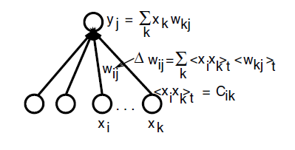
PCA for one neuron
Let's assume that the environment is composed only
of the diagonal lines.
Let's accept a linear activation for moment t (image nr t):
Let the change of weight values be specified by a simple Hebb rule:
w_{ij}(t+1) = w_{ij}(t) + ε x_{i} y_{j}
After presentation of all the images:
The change of weights is proportional to the average of the product of the inputs*outputs. Correlation can replace average.

Slide 24
Hebbian Correlations
Correlation:
If the averages are zero and the variance is one then the average of the product is the correlation; the change in weights is proportional to:
C_{ik}=⟨x_{i}x_{k}⟩_{t} are correlations between inputs; the average of the weights changes slowly. The change in weight for input i is then the weighted average of the correlations between the activity of this input and the remaining ones.
After the presentation of many images, the weights will be dominated by the strongest correlations and y_{j} will calculate the strongest component of PCA.

Slide 25
Normalization
The simplest normalization avoiding an infinite increase in weights:
Δw_{ij} = ε (x_{i} – w_{ij}) y_{j}
Erkki Oja (1982) proposed: Δw_{ij} = ε (x_{i} –y_{j} w_{ij}) y_{j}
For one unit, after learning the weights stop changing:
Δw_{ij} = 0 =ε (x_{i} –y_{j} w_{ij}) y_{j}
Weight w_{ij} = x_{i} /y_{j} = x_{i} / Σ_{k} x_{k} w_{kj}
The weight of a given input signal is then a fraction of the complete weighted activity of all the signals.
This rule also leads to the calculation of the most important main component. How to calculate the other components?

Slide 26
Problems with PCA
How to generate the succeeding PCA components in neural networks?
We may perform orthogonalization of successive y_{j} numerically, but this is not easy to do with the help of a neural network.
Sequential PCA orders components, from the most important to the least; this can be achieved by introducing connections between hidden neurons with strong inhibition, but this is an artificial solution.
PCA assumes a hierarchical structure: the most important component for all images, in effect we get eg. for image analysis, successive components as chessboards with an increasing number of squares since the correlations of pixels for a large number of images disappear.
The problem with PCA can be characterized as:
PCA calculates correlations in the entire input space whereas useful correlations exist in local subspaces.
Natural images create heterarchies, different combinations are equally important for different images, subsets of features relevant for certain categories are not important for differentiating others.

Slide 27
Conditional PCA
Conditional principal component analysis (CPCA): calculate correlations not for all features but only for these features which are present in selected images.
PCA functions on all features, giving orthogonal components.
CPCA functions on subsets of features, ensuring that different components encode different interesting combinations of signal features, eg. edges.
The competition realized with the help of kWTA will ensure the activity of different neurons for different images.
In effect, it will create receptive fields => that can be combined to recreate images
How to do this with the help of neurons?

Slide 28
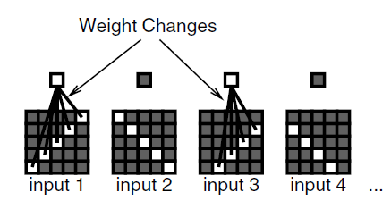
CPCA equations
Neurons are trained on subsets of images
with predetermined features, eg.
edges slanting in a certain way.
Each subset may be embedded in many
uncorrelated patterns, but should be
repeated frequently.
Normalized Hebb's rule is used:
Δw_{ij} = ε (x_{i} -w_{ij}) y_{j}
The weights move in direction x_{i}, on condition that there is activity y_{j}.
In effect the conditional probability for inputs/outputs in [0,1]:
P(x_{i} =1|y_{j} =1) = P(x_{i}|y_{j}) = w_{ij}
The weight w_{ij} = the probability that the input unit x_{i} is active given that the receiving unit y_{j} is also active. For uncorrelated pixels it will be small.

Slide 29
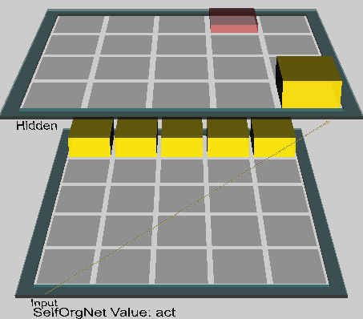

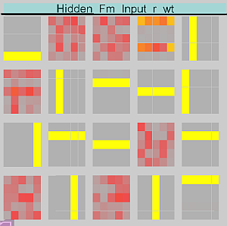
CPCA self-organized learning
Chapter 4: Self_org.proj, learn in simple environments!
Inputs: 5 horizontal and 5 vertical bars, 2 shown at one time: one in some position plus all possible context, all 9*10/2=45 combinations, creating conditional PCA inputs, with correlations for pixels in lines. kWTA, k=2 used.
<= Selective representations appear

Slide 30
Probabilistic interpretation
The success of CPCA depends on the selection of a function determining the activity of neurons – an automatic determination process is possible in a few ways: self-organization or error correction.
Activations averaged over time are represented by probabilities P(x_{i}|t), P(y_{j}|t). The change in weights for all images t appearing with P(t):
Δw_{ij} = ε [Σ_{t} (P(y_{j}|t) P(x_{i}|t) -P(y_{j}|t)w_{ij}] P(t)
In a state of equilibrium Δw_{ij} =0 so:
w_{ij} = Σ_{t} P(y_{j}|t)P(x_{i}|t)P(t) / Σ_{t} P(y_{j}|t)P(t) =
Σ_{t} P(y_{j},x_{i},t) / Σ_{t} P(y_{j},t) = P(x_{i} ,y_{j})/P(y_{j}) = P(x_{i}|y_{j})
Weight w_{ij} = conditional probability x_{i} under condition y_{j}.
How to biologically justify normalization?

Slide 31
Biological interpretation
Normalized Hebb's rule:
Δw_{ij} = ε (x_{i} -w_{ij}) y_{j}
Let's assume that the weights are w_{ij} ~0.5, there are then 3 possibilities:
1. x_{i} , y_{j} ~1 (a strong pre- and postsynaptic activity), so x_{i} > w_{ij},
weights increase, so we have LTP, as in NMDA channels.
2. y_{j} ~1 but x_{i} < w_{ij}, weight decrease, we have LTD, a weak input signal
will suffice to unblock the Mg²⁺ ion of NMDA channel.
A strong postsynaptic activity can also unblock other voltage dependent channels and introduce a small amount of Ca++.
3. Activity y_{j} ~0 doesn't give any changes, voltage channels and NMDA
aren't active.
Learning happens faster for small w_{ij}, because x_{i} < w_{ij} more often.
Qualitatively consistent with observations of weight saturation.

Slide 32
Normalization of weights in CPCA
CPCA weights are not very selective, don't lead to image differentiation – they don't have the dynamic range.
For typical situations P(x_{i}|y_{j}) is small, but we want it around 0.5.
Solution: renormalization of weights and contrast enhancement.
Normalization: uncorrelated signals should have a weight of 0.5, but in simulations with seldom appearing signals x_{i} approach a value of α~0.1-0.2. Let's factorize the weight change into two terms:
Δw_{ij} = ε (x_{i} -w_{ij}) y_{j} = ε [(1-w_{ij}) x_{i} y_{j}+(1-x_{i})(0-w_{ij})y_{j} ]
The first term causes an increase in weights in the direction of 1, the second causes a decrease in the direction of 0; if we want to maintain average weights around 0.5 we must increase the first term, eg. :
Δw_{ij} = ε [(0.5/α−w_{ij}) x_{i} y_{j}+(1-x_{i})(0-w_{ij})y_{j} ]
The linear correlation is still w_{ij} = P(x_{i}|y_{j}) 0.5/α . The simulator has a parameter savg_cor∈[0,1] determining the degree of renormalization.

Slide 33
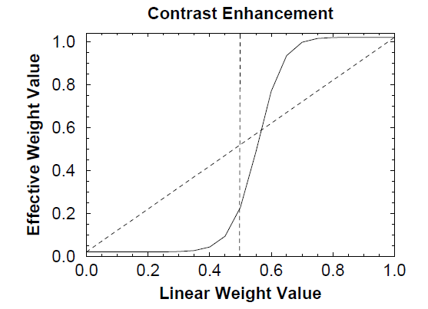
Contrast in CPCA
Instead of a linear weight change we want to ignore weak correlations and strengthen strong correlations – to increase the contrast between interesting aspects of signals and those that are not.
This increases the simplicity of the connections (the weak ones can be skipped) and accelerates the learning process, helping the weights decide what to do.
Contrast enhancement:
instead of a linear weight change use a sigmoidal one:
Two parameters: gain γ and offset θ. θ>1 imposes higher threshold
Attention: this is a scaling of individual weights not of activations!

Slide 34
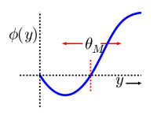
BCM/XCAL Model
More recently BCM rule (Bienenstock, Cooper & Munro, 1982) has been used;
assuming homeostatic mechanism that regulate neural activity,
each hidden unit should be active for about the same % of time as other units.
Dynamic threshold θ based on neuron activity is used to modify Hebb rule:
Δw_{ij} = x_{i} y_{j} (y_{j} −θ_{i}), θ_{i} = <y_{j}>²
Final neuron output grows for large y and then saturates,
similar to the dependence of synaptic plasticity on Ca²⁺ levels.
This is effective when:
the relevant features are uniformly distributed in the environment,
there is a good match between the number of units in the hidden layer and the number of features.
Used in the new eXtended Contrastive Attractor Learning (XCAL) model in Emergent, but it is not clear how that changes results.

Slide 35
What it will be about
Self-organized learning: creating topographic representations.
Hebbian correlation learning.
Error-driven task learning.

Slide 36
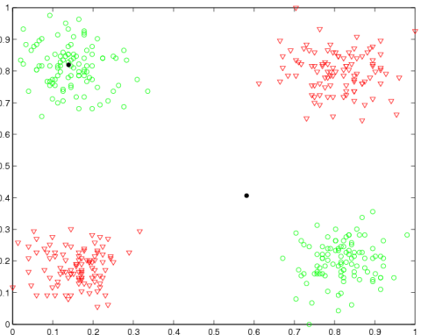
Hebbian learning has problems
Hebbian learning based on correlations <x_{i}y_{j}> fails for many mappings X=>Y
For example:
y=x₁.xor.x₂, or (0,0)=>0, (1,1)=>0, (0,1)=>1, (1,0)=>1,
all <x_{i}y_{j}>=1/2.
If y = color green or red, and x = position in 2D correlations are not sufficient.
All two-class categorization problems that are not separable by a single hyperplane cannot be solved this way.
For a large number of inputs x almost all problems are not separable.
Learning of tasks or general mappings requires another approach.

Slide 37
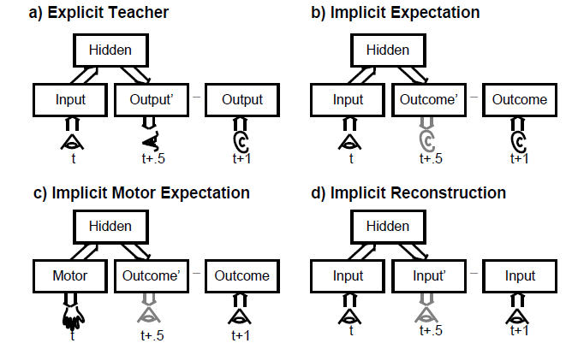
Task learning
In task learning there is a goal, and a mechanism to check if it has been reached, so the learning is error-driven.
Where do the goals come from?
Internal or external teacher: confronting performance with expectations (predictions) of internal models, using burst of dopamine for reward.
Input at time t output t+1; ex: speech after reading.
a) explicit input signal,
action + correction signal;
b)internal expectation,
action + self-correction;
c) implicit motor expectation
d) implicit internal reconstruction (internal second input, coming for ex. from parietal cortex).

Slide 38
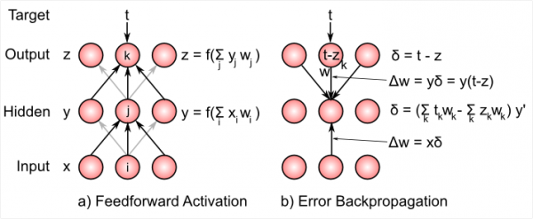
Delta rule and BP
Delta rule is the optimal way to reduce error in a 2-layer network, without hidden units (Widrow, Hoff 1960), or gradient discent in linear regression.
Idea: correct w_{ik} weights when errors are large, do not correct where errors are quite small.
Delta = error estimation, starting from the output, propagates to input.
Feedforward step: calculate outputs, backward step: calculate errors and make corrections proportional to these errors.

Slide 39
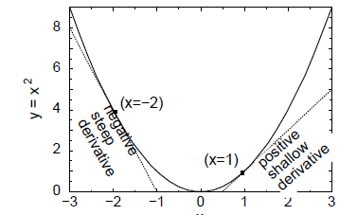
Error function
E(w) – error function depends on all network parameters w, it is an average over all errors E(X;w) for input patterns X.
o_{k}(X;w) – output values of neuron k in the network (y, z values etc) for X.
t_{k}(X;w) – target values on k neuron for input X.
For single input X, and one parameter w
In minimum E(X;w) for parameters w
derivatives are all dE(X;w)/dw = 0.
For many parameters derivatives over each parameter are calculated dE/dw_{i}, gradient = 0. Error correction and backpropagation ⬄ minimization of error f.
Errors may not always reach 0, but if the network has sufficiently many parameters for finite number of input patterns X it may find a solution (set of parameters) for which minimum error is reached – but it may lead to overfitting, reducing generalization!

Slide 40
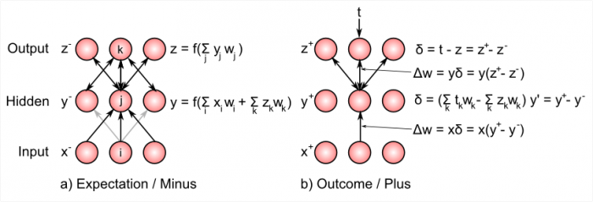
GeneRec/XCAL
Backpropagation is the most popular approach to mulit-layer perceptron networks but and can learn arbitrary input-output relation, but it is hard to find biological justification for such process. Emergent uses modified rule.
GeneRec (General Recirculation, O’Reilly 1996),
Bidirectional flow, w_{kl} ≠ w_{jk}, in backprop same weights, and only error flows.
Expectation, or minus phase: settle input activations.
Hidden units are driven both by inputs and activations that from outputs. Outcome, or plus phase, target values drive the output and hidden units.
Plus-minus phase difference approximates BP delta rule Δw_{ij} = ε x_{i} (y_{j}⁺−y_{j}⁻)

Slide 41
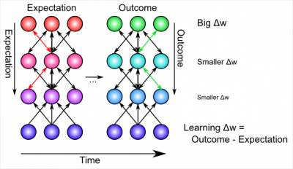


Hebb + error correction
Both approaches are needed:
Correlation learning and error terms:
− and + phases, expectations and feedbacks, alternate quickly, ~ 0.1 sec.
Weighted combination
kWTA implements inhibition inside layers, creating sparse internal representations. Neurons compete with each other and only the best neurons, specializing in a given task and only the most confident (i.e. highly active), are left.

Slide 42
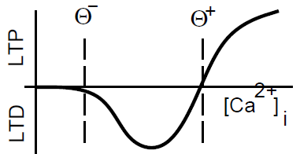

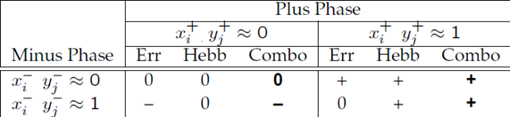
Combo properties
Hebbian learning creates a model of basic features of the world, correlations between events and features but is not able to learn heteroasscociations.
Hidden layers allow for transformation of data into different feature space while error correction learns arbitrary input-output relations (behaviors).
Combined Hebbian correlation learning (x_{i} ~ y_{j}) and error correction learning should be able to learn everything in a biologically plausible way.
Connections in the brain are bidirectional.
Biology: no Ca²⁺ = no learning;
little Ca²⁺ = LTD,
a lot of Ca²⁺ = LTP.
+ = LTP, − =LTD in the table,
LTD = unfulfilled expectations,
only the – phase without enhancement from the
+ or outcome phase.

Slide 43
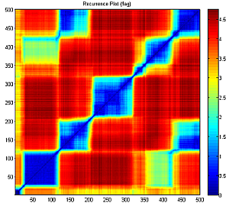
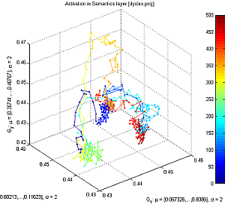
Multiple constraint satisfaction
Bidirectional connectivity leads to an attractor dynamics, or multiple constraint satisfaction: the network can start off in many initial states (the region called basin of attractor) and evolve towards specific attractor or prototype state, representing cleaned-up, stable interpretation of a noisy or ambiguous input pattern.
This state is a compromise between multiple constraints, minimizing overall energy of the system.
Color = distance from the point at a given time shown on x, y axis.
Color
= time, several attractors for words, fast transitions;
axis (x,y,x) = position.
Attractor dynamics is best visualized using recurrence plots or using Fuzzy Symbolic Dynamics technique to see high-dimensional trajectories.

Slide 44
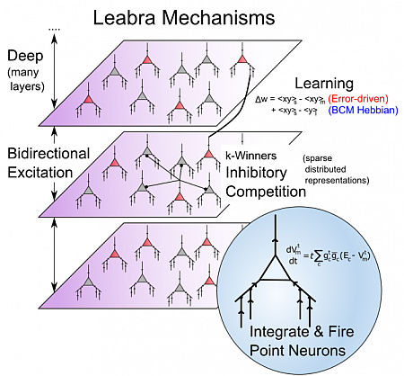
Leabra learning model
Leabra =
Learning in an Error-driven and Associative, Biologically Realistic Algorithm
So far we are discussing only how local learning is possible, but all this has to be embedded in overall cognitive architecture.
6 principles embedded in Leabra:
integrate & fire point neurons, kWTA, sparse distributed representations, many layers of transformation, Hebb & error correction learning.

Slide 45

Back-up your memory!

