Slide 1
Włodzisław Duch: education, degrees, positions
Postdock, G.A. Segal, USC, Los Angeles
MSc theoretical physics
AvH Fellow, MPA, Monachium
Born!
Visiting Prof. SCE NTU Singapore
1954
1972
1977
1980-
1982
1985-
-1987
1997
2003
2010
DSc (habil)
Professor title
Studing physics, NCU
PhD, J. Karwowski Einstein No. 3
Max Planck Inst. of Astrophysics
Nanyang VP NTU Singapore
Co-founder PTSN 1994, PSSI 2010, PP-RAI 2018
President (2006-11) European Neural Network Society (ENNS)
Fellow (2013), International Neural Network Society (INNS) Board of Governors 2003
Fellow (2022), International Artificial Intelligence Industry Alliance
Fellow (2023), Asia-Pacific Artificial Intelligence Association
IEEE TNNS, CIS, editorial positions in many journals …
Neurocognitive Lab (2014), Neuroinformatics and AI group (2020) at NCU

Slide 2
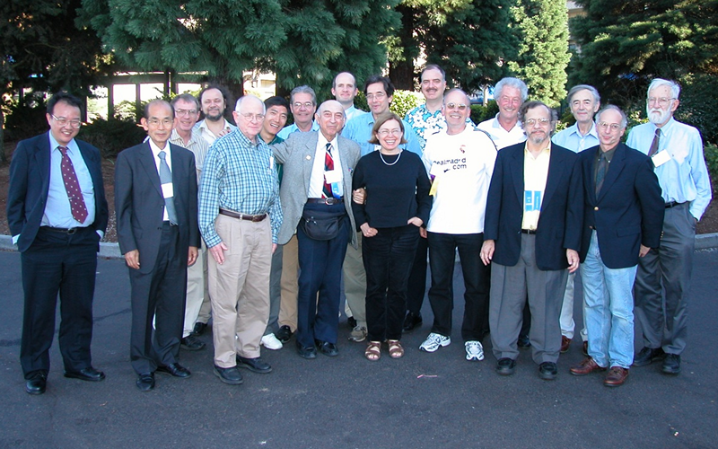
INNS Board of Governors

Slide 3
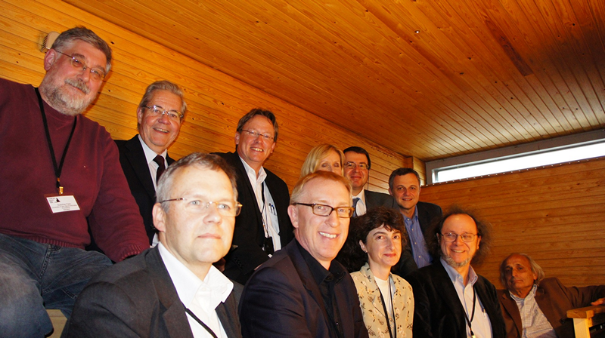
ENNS Executive Board, Presidential Sauna, Espoo, Aalto University

Slide 4
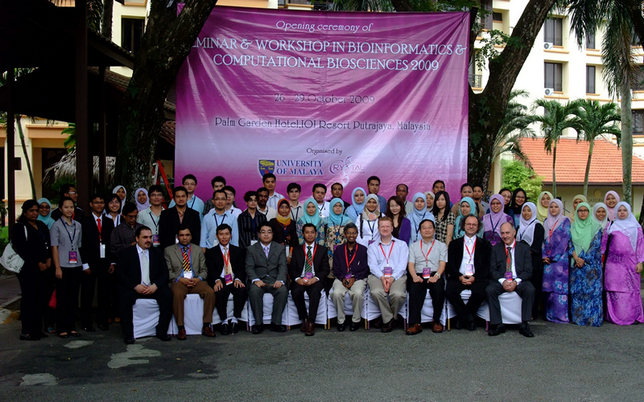
University of Malaya

Slide 5
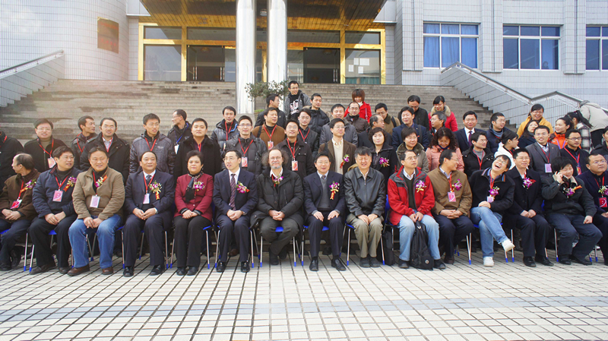
Jiangxi University of Science and Technology, honorary chairman

Slide 6
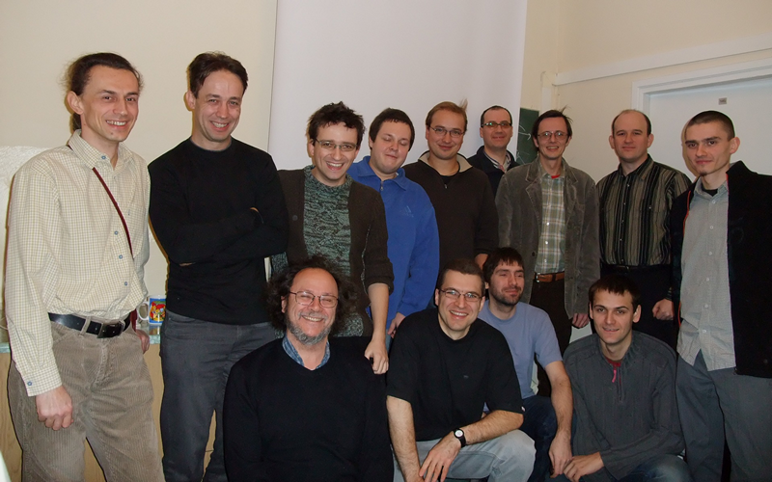

Slide 7
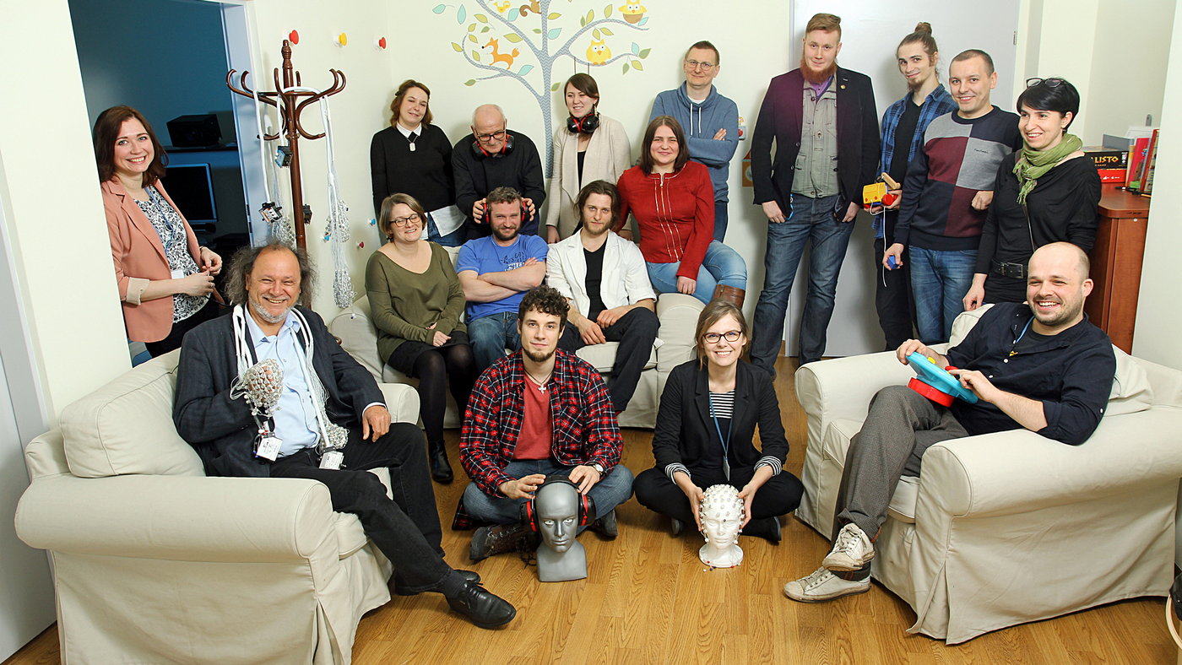

Slide 8
